Slide 1


SMARTJOBS Vision 2025 - Executive Meeting
Business Excellence Team

Slide 2
MEETING AGENDA
Executive Summary
Key Focus Area
Way Forward
Questions & Answers
Notes:
Further develop each questions asked in the beginning
Give examples to illustrate State the consequences if no action is taken
Expand on the solution and other alternatives

Slide 3
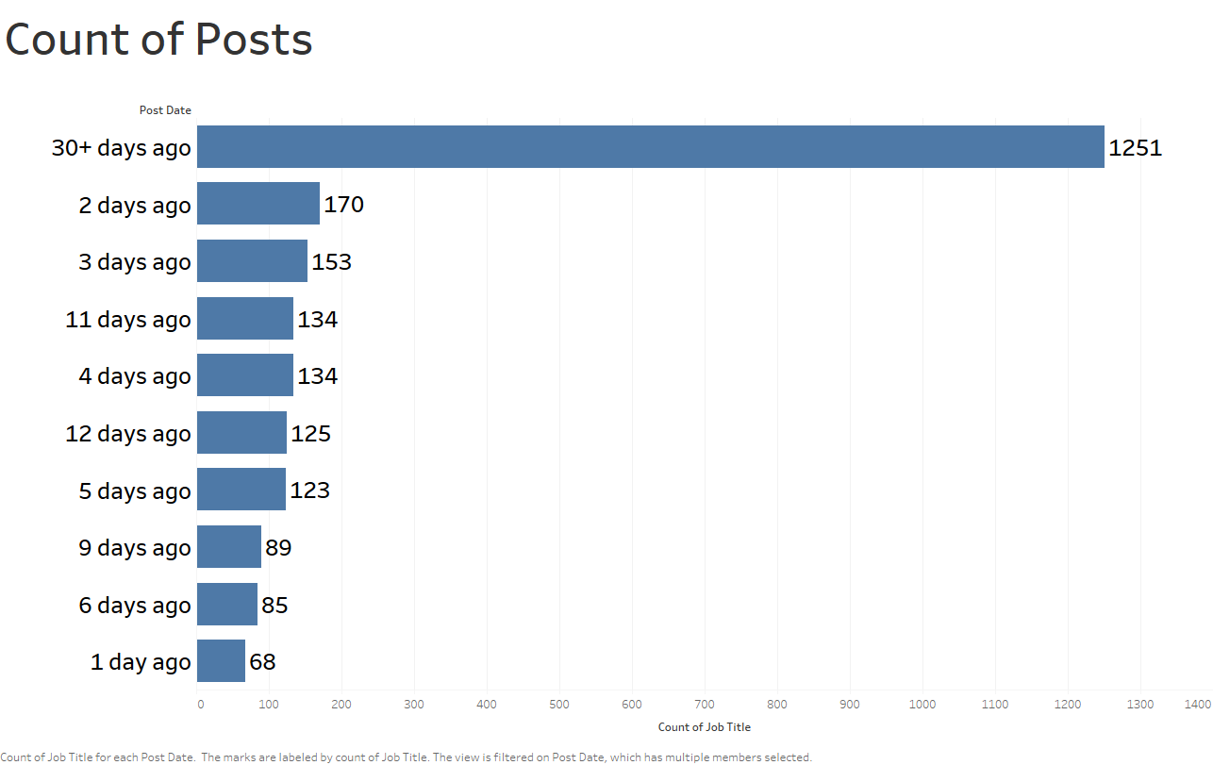
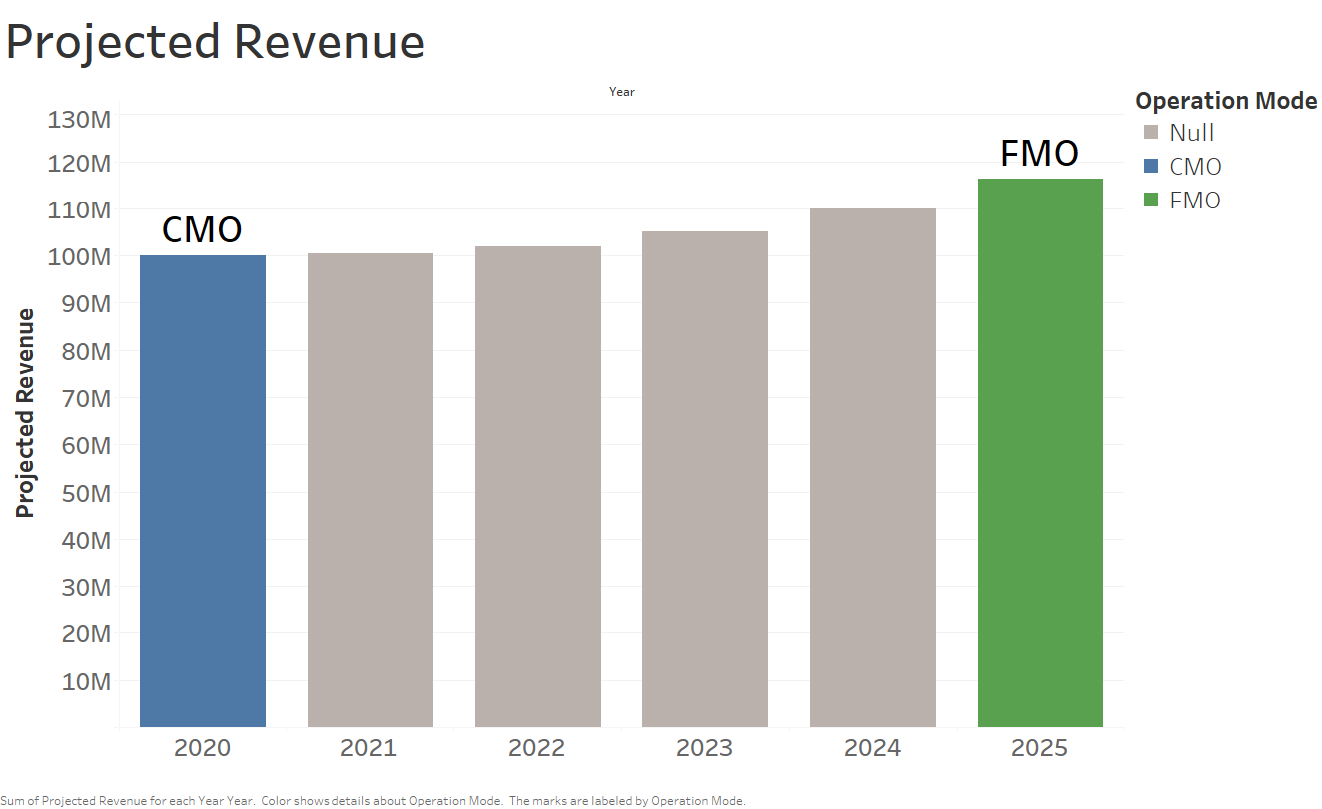
Executive Summary
Overview
As a part of “SMARTJOBS Vision 2025” initiative, company wants to increase the revenue and customer base.
Following are the challenges:-
Attracting New Customers
Reducing Operational cost
By introducing Premium Plans for employers who are taking more than 30 days to close the post and by attracting new job seekers, company will increase revenue by:
15%
Actions
Create attractive plans for both customers i.e., Job Seekers and Employers
Improve website traffic by using PPC and other marketing methods.
Give offers to new companies to use websites during the initial stage.
Introduce plans for fresh job seekers
Build platform which can interconnect different platform
Recommendations
Create plans specific to job categories.
Create a system to monitor redundant posts and warn the user before deleting it
Reach out to recruiter in top cities
Reach out to freshers through colleges
15% increase in Revenue

Slide 4
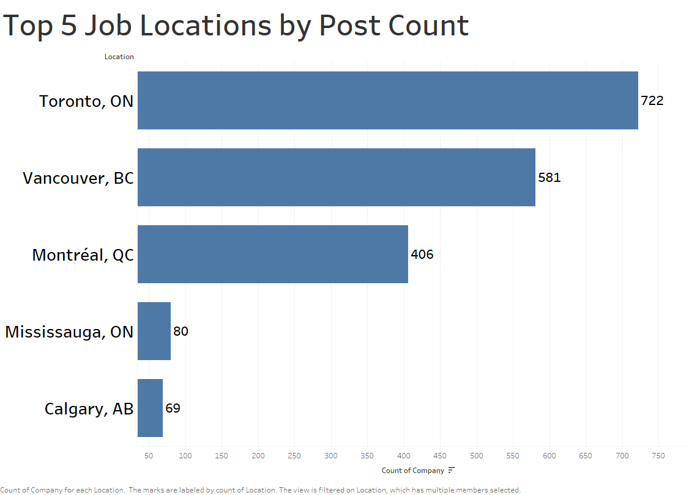
Key Areas to Focus
Marketing team should concentrate on Top 5 locations to add more employers
Value added services has to be provided for Top 5 locations customers. i.e., interview planning, resume sorting etc.
Features has to be added for shortlisting and rank of job seekers profile according profile match
Notes:
Further develop each questions asked in the beginning
Give examples to illustrate State the consequences if no action is taken
Expand on the solution and other alternatives

Slide 5
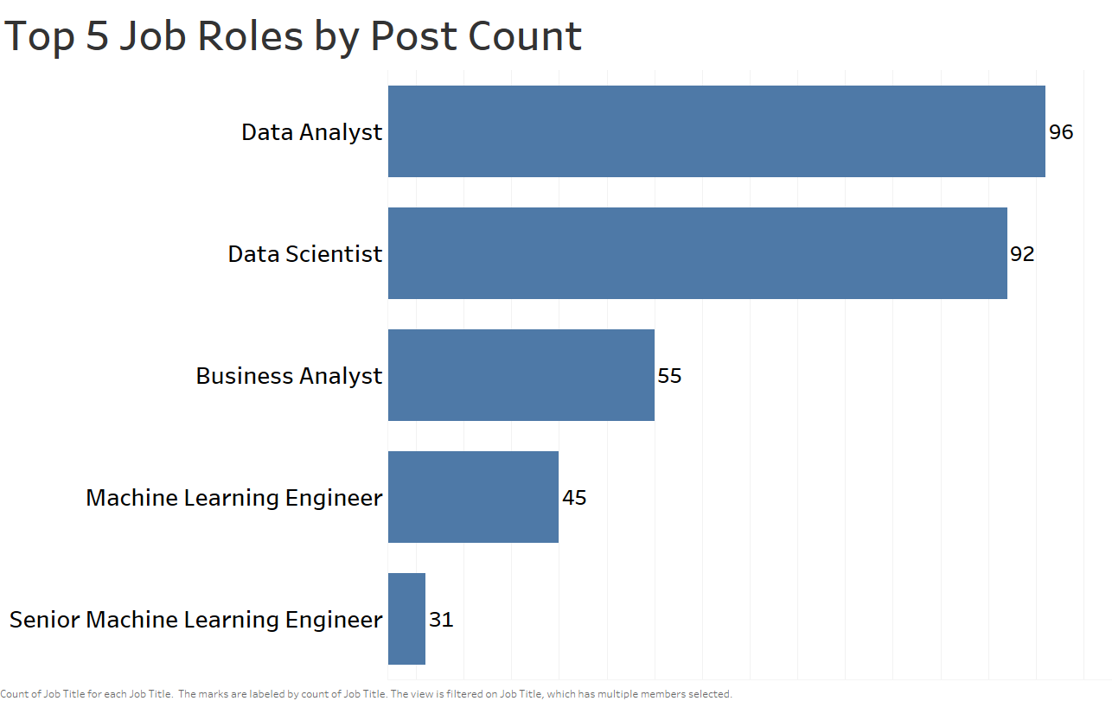
Key Areas to Focus
Attract more job seekers in top 5 job roles
Develop inbuilt resume building system
Skill development program integration
Self Assessment
Notes:
Further develop each questions asked in the beginning
Give examples to illustrate State the consequences if no action is taken
Expand on the solution and other alternatives

Slide 6
Way Forward
Marketing team should take action to reach out to top recruiter and colleges in top cities
Development team should work on integration of our platform with customer portals.
Financial Team should focus on building premium plans for the customer i.e., for both employers and job seekers.
As a value addition for job seekers, skill development programs also need to be developed
Host Online Job fairs for attracting new customers to our portal
Notes:
End with a call to Action
Illustrate the benefit of your proposed solution
Let your narrative inform the audience on the role they are to play in ensuring that the challenge is resolved.
What will be the roadmap going forward?

Slide 7

Questions
&
Answers
Post your ideas: vision2025@smartjobs.com
Notes:
End with a call to Action
Illustrate the benefit of your proposed solution
Let your narrative inform the audience on the role they are to play in ensuring that the challenge is resolved.
What will be the roadmap going forward?

Slide 8

Tentative Review Meeting: Q4 FY23

